Slide 1
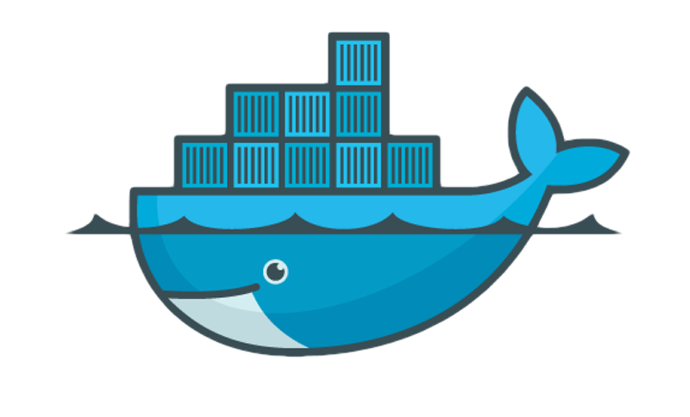

Docker
Docker for Developers
Claudius Link

Slide 2

http://bit.ly/1qHJmCb
Notes:
Wer kennt Docker?
Wer weiss was Docker ist?
Wer nutzt Docker?
Wer entwickelt für Linux? (bzw. etwa was irgendwann mal auf einem Linux Server läuft)
Wer arbeitet unter
Linux?
Mac OS X?
Windows?

Slide 3
Warning
!
Opinions expressed are my own
Views of a developer (not a Cloud Operator)
Not a long time Docker User

Slide 4
What is Docker?
Lightweight “VM”
Tooling
Creation, Distribution, Deployment
Versioning
for Linux

Slide 5
Lightweight!?
Native
$ time cat /etc/issue
Ubuntu 12.04.4 LTS (Precise Pangolin) \n \l
real 0m0.002s
user 0m0.001s
sys 0m0.002s
Docker Container
$ time docker run -i -t ubuntu:14.04 cat /etc/issue
Ubuntu 14.04.1 LTS \n \l
real 0m0.455s
user 0m0.017s
sys 0m0.005s

Slide 6
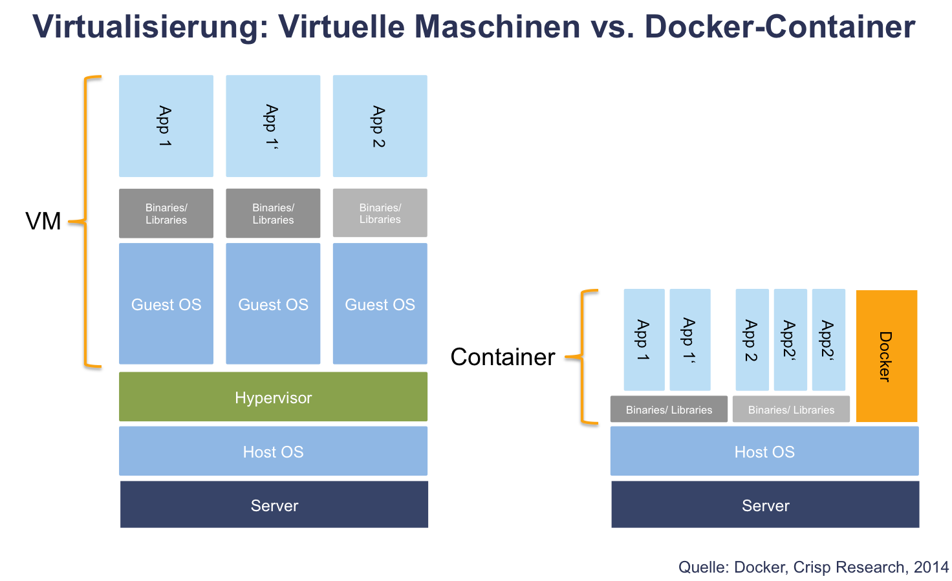

Slide 7
Docker vs. VM
No Init
No Services
Shared Kernel
Isolation:
Process & Memory
Network
Notes:
Ubuntu 12.04
42 init.d start scripts on runlevel 2 (ls /etc/rc2.d/S* | wc -l)
14 running services (service --status-all 2>&1 | grep + | wc -l)
Isolation through cgroups/lx containers
Changeroot ond steroids
pid: process isolation (PID: Process ID).
net: managing network interfaces (NET: Networking).
ipc: managing access to IPC resources (IPC: InterProcess Communication).
mnt: managing mount-points (MNT: Mount).
uts: isolating kernel and version identifiers. (UTS: Unix Timesharing System).

Slide 8
Inside Docker
Images
Containers
Layers

Slide 9
Inside Docker: Images
Images
Containers
Layers
debian
ubuntu:14.04
fedora:heisenbug
…
$ docker pull ubuntu:latest
$ docker images
REPOSITORY TAG IMAGE ID CREATED VIRTUAL SIZE
ubuntu latest 826544226fdc 5 days ago 194.2 MB
…
Notes:
Read-only templates
Typically you get them from a repository (docker search, docker pull)
or build them yourself and put them into an repository (docker import, docker push)
or from a local cache
Careful if you don’t specify a Tag ALL matching images are downloaded

Slide 10
Inside Docker: Containers
Images
Containers
Layers
docker run ubuntu
ubuntu
$ docker run -i -t ubuntu
$ docker ps
CONTAINER ID IMAGE COMMAND CREATED STATUS PORTS NAMES
589e9d33c919 ubuntu:latest "/bin/bash" 24 seconds ago Up 24 seconds thirsty_almeida
Notes:
-i interactive
-t attach an terminal

Slide 11
Inside Docker: Layers
Images
Containers
Layers
docker run ubuntu
Content Layer
ubuntu
$ docker run -i -t ubuntu
$ docker ps
CONTAINER ID IMAGE COMMAND CREATED STATUS PORTS NAMES
589e9d33c919 ubuntu:latest "/bin/bash" 24s ago Up 24s thirsty_almeida
Notes:
docker diff

Slide 12
Inside Docker:
Images = Image + Layer
apt-get install -y vim
Content Layer
ubuntu
# apt-get update
# apt-get install vim
$ docker commit -p 589e9d33c919 ubuntu_vim
$ docker images | grep ubuntu_v
ubuntu_vim latest 33e231eca143 2 minutes ago 237.7 MB

Slide 13

Inside Docker
Images = Image + Layer
# Dockerfile
FROM ubuntu
RUN apt-get update -y
RUN apt-get install -y vim
$ docker build -t ubuntu_vim .
$ docker images | grep ubuntu_v
ubuntu_vim latest 2d7bea1fd284 4m ago 258 MB
Notes:
To address caching “problems” --no-cache might be necessary when building

Slide 14
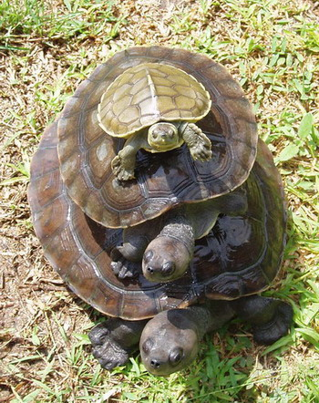
Turtles Layers all the way down
http://commons.wikimedia.org/wiki/File:River_terrapin.jpg

Slide 15
Containers and the World

Slide 16
Filesystem
Share files
Folder
Data Voluments
# Dockerfile
…
COPY listen.sh listen.sh
$ docker run -i -t -v $PWD/listen.sh:/listen2.sh ubuntu_vim
$ docker run -i -t -v /tmp:/mnt/tmp ubuntu_vim
$ docker run -d -v /data --name data ubuntu_vim echo "Data"
$ docker run -i -t --volumes-from data ubuntu_vim
Notes:
docker run -i -t --volumes-from data ubuntu_vim
ls /data
touch /data/fobar
docker run -i -t --volumes-from data ubuntu_vim
ls /data

Slide 17
Networking
Port forwarding
Linking
$ docker run -p 5001:5001 -i -t ubuntu_vim
# ./listen.sh 5001
$ telnet 192.168.59.103 5001

Slide 18
Use Cases

Slide 19
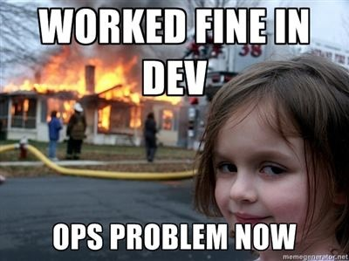
http://i.imgur.com/3CS31.jpg
Notes:
Ship development machines

Slide 20
Multi-platform Development
Workstation: Ubuntu 12.04 64bit
Target 1: SLES 11 32bit
Target 2 RHEL 6 32bit
…
Ubuntu 12.04 64bit
SLES 11 32bit VM
RHEL 6 32bit VM
No Fun
Test VMs …
Windows VM
Notes:
> 2 VMs are no fun

Slide 21
Version Management
Replace
rvm
npm
CLASSPATH
….

Slide 22
Boot2Docker
(Windows & Mac OS X)
# Create VM
$ boot2docker init
# Start VM
$ boot2docker start
# Get the endpoint for the client
$ boot2docker socket
# Export Endpoint
$ export DOCKER_HOST=tcp://<IP>:<PORT>
# Happy Dockering
$ docker run -t -i ubuntu
Notes:
On windows some ssh tools are required

Slide 23
Users

Slide 24








Docker Users

Slide 25
Security

Slide 26
More information
https://www.docker.com
Slides https://github.com/linkclau/docker-doc

